Slide 1
LAWGORITHM:
AI AUTOMATED LEGAL ADVISORY
Team 05
Name Roll No.
M.S.N.M.S.D.PRAMOD 22VV1A0531
M. DEVI AKSHAYA 22VV1A0527
Y.DHARANI 22VV1A0557
CH.N.S.S.SANKAR 22VV1A0510
Project Guide:
Prof. R. D. D. V. Sivaram Sir

Slide 2
OUTLINE
INTRODUCTION
EXISTING MODEL
LIMITATIONS (EXISTING MODEL)
LITERATURE SURVEY
PROBLEM STATEMENT
PROPOSED SYSTEM
SYSTEM FLOW
TECHNOLOGIES USED
RESULTS
CONCLUSION

Slide 3
INTRODUCTION
Lawgorithm is an AI-based legal support system that helps police officers and legal professionals handle criminal cases more efficiently. It can automatically prepare important legal documents such as FIRs, investigation questions, charge sheets, and verdict predictions using plain-text case details.
The system reads and understands case descriptions written in everyday language and converts them into proper legal documents that follow Indian laws. By doing this, Lawgorithm reduces paperwork, saves time, ensures uniformity, and helps speed up legal procedures.

Slide 4
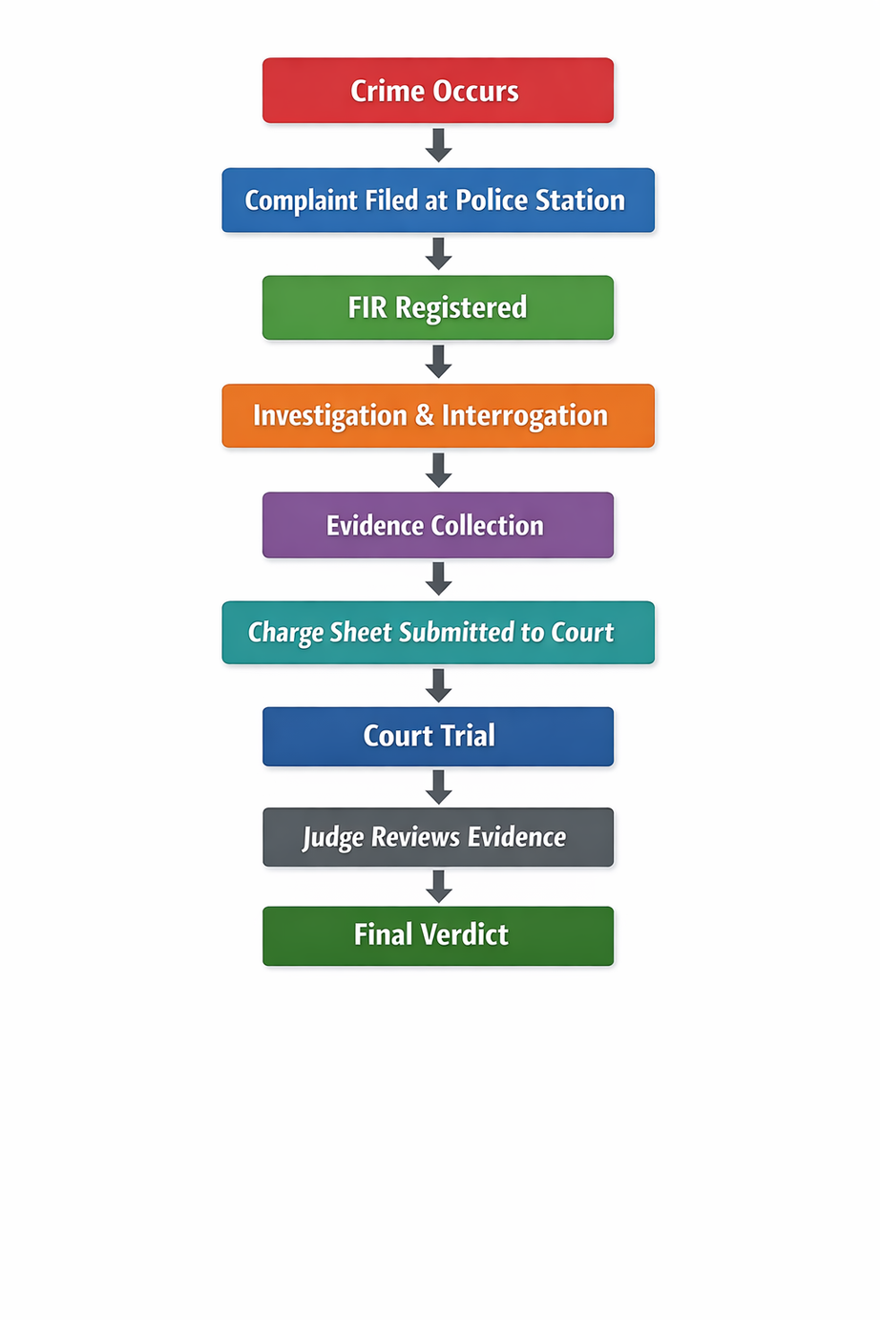
EXISTING MODEL

Slide 5
LIMITATIONS(EXISTING MODEL)
Manual Documentation:
This can lead to human errors, missing information, or document damage.
Slow Investigation Process:
Paperwork takes significant time.
Risk of Data Manipulation:
Physical records can be tampered with, lost, or altered.

Slide 6
LITERATURE SURVEY (PAPER 1)
Title: Explainable AI and Law: An Evidential Survey
Authors: Multiple authors
Publication Medium: Springer – AI and Ethics
Publication Date: 2023
Methodology:
Surveys explainable AI (XAI) techniques applied to legal reasoning
Categorizes legal AI systems based on task complexity
Emphasizes interpretability over pure prediction accuracy

Slide 7
LITERATURE SURVEY (PAPER 1)
Key Insights:
Legal AI systems must justify decisions transparently
Rule-based and reasoning-oriented models are preferred in legal domains
Black-box models reduce trust in judicial settings
Relevance to Lawgorithm:
Lawgorithm follows a first-principles statutory reasoning approach, ensuring explainability in verdict prediction and legal document generation.

Slide 8
LITERATURE SURVEY (PAPER 2)
Title: Sentence-Transformers with MiniLM for Semantic Text Embeddings
Model: all-MiniLM-L6-v2
Authors:
Nils Reimers
Iryna Gurevych
Wenhui Wang
Furu Wei
Publication Medium:
Association for Computational Linguistics (NLP research publications)
Released via Sentence-Transformers and hosted on Hugging Face
Publication Date: 2021

Slide 9
LITERATURE SURVEY (PAPER 2)
Methodology:
Uses the MiniLM transformer within Sentence-Transformers.
Converts sentences into 384-dimensional embeddings.
Trained with contrastive learning for semantic similarity tasks.
Key Insights:
Lightweight model with strong semantic search performance.
Enables fast similarity comparison using vector embeddings.
Relevance to Lawgorithm:
Can encode legal texts for the semantic retrieval of relevant statutes.

Slide 10
PROBLEM STATEMENT
The traditional legal workflow involves extensive manual documentation and subjective interpretation, leading to inefficiencies, delays, and inconsistency. There is a need for an AI-based system that can accurately convert case narratives into legally structured outputs and generate the verdict using previous proceedings while maintaining transparency, unbiased, and fairness.

Slide 11
TECHNOLOGIES USED
Frontend: React, Vite, Tailwind CSS
Backend: FastAPI (Python), Semi-Agentic AI, Semantic Expansion
LLM Model: LLaMA 3.3 70B
Sentence Bert: all MiniLM
Data Handling: JSON-based structured outputs converted into vectors

Slide 12
DATA SET OVERVIEW-LEGAL SECTIONS
Dataset Contents: IPC, CrPC, CPC, MVA, HMA, IMA, IEA, NIA
Each record in the dataset includes:
Section Number (e.g., IPC 378)
Section Title
Legal Definition / Description
Dataset Format:
Stored in JSON
Easily searchable and machine-readable
Purpose of the Dataset:
Converts the dataset into vectors for semantic search while the case details are given for the FIR generation phase.

Slide 13
DATA SET OVERVIEW-PREVIOUS PROCEEDINGS
Dataset Contents:
The data set contains
Facts
Sections applied
Verdict
Dataset Format:
Stored in JSON
Easily searchable and machine-readable
Purpose of the Dataset:
Converted into vectors for RAG usage for finding the relevant verdicts for the case, while generating the verdicts

Slide 14
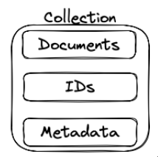
CHROMA DB
Collection: A container in Chroma that stores related documents, embeddings, IDs, and metadata together.
Document: The actual text data (like a sentence or paragraph) stored in the collection and converted into vector embeddings for search.
ID: A unique string identifier assigned to each document so it can be retrieved, updated, or deleted.
Embedding: A vector (list of numbers) that represents the meaning of a piece of text so a computer can compare it with other texts for similarity.
Metadata: Additional information about a document (e.g., topic, source, author) used to filter or organize search results.

Slide 15
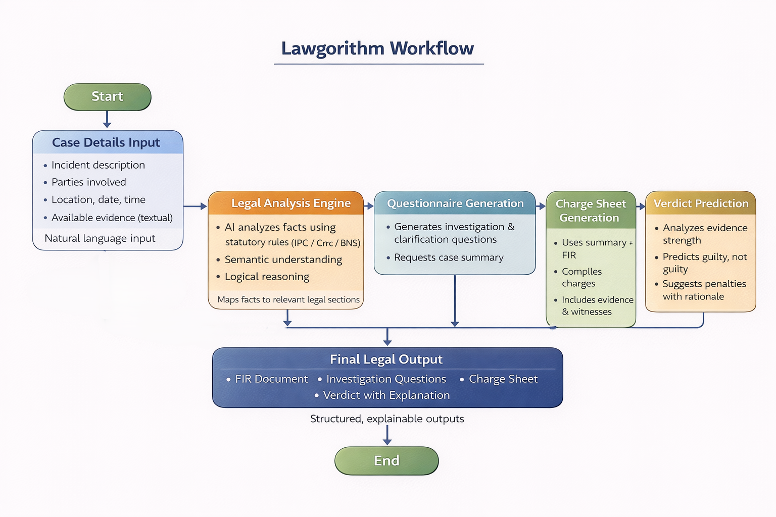
PROPOSED SYSTEM AND FLOW

Slide 16
METHODOLGY
Data Collection
Data Preprocessing
Vector Conversion
Vector Storage
FIR
Generation
Questionaire &
Summary
ChargeSheet generation
Verdict
Prediction

Slide 17
ARCHITECTURE OF AL MINILM(SBERT)
Raw Text
"I love NLP”
Tokenization
["I","love","N","##LP"]
Token IDs
[1045, 2293, 1050…]
Token Embeddings
(Dense vectors)
768-d each token
Sentence Vector
(Single 768-d embedding)
Pooling Layer
Mean / CLS / Max pooling
Transformer Encoder
(Self-Attention layers)
Context-aware embeddings
Positional Embeddings
(Word order info)

Slide 18
PHASES
Phase 1: FIR Generation
Takes natural-language case/complaint details from the user.
Uses a semi-agent for guessing the IPC sections that are relevant to the case to enhance accuracy.
Analyzes the complaint using Sentence-BERT to identify relevant legal sections.
Displays the AI-generated FIR in proper legal format with PDF download.
Generates a structured FIR document using LLMs and sends it to the frontend.
Technologies:
Sentence-BERT
Semantic-Expansion & Search

Slide 19
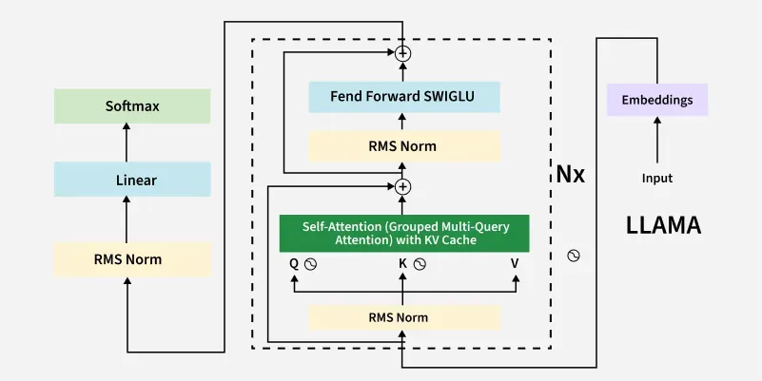
ARCHITECTURE OF LLAMA 3.3 70B

Slide 20
PHASES
Phase 2: Investigation Questionaire
Allows the user to request investigation / cross-examination questions.
Displays role-based questions (complainant, accused, witnesses).
Agent reads FIR → identifies gaps → designs questions.
Generates context-aware questionnaires for investigation support.
Technologies:
LLM Model - Llama 3.3 70B

Slide 21
SPEECH TO TEXT
Uses the browser's built-in Web Speech API — no external library
User clicks the Mic button on the form field
The browser requests microphone permission from the user
Language is set to en-IN (Indian English)
Captures one speech at a time and stops automatically
Converts spoken audio into a text transcript
Transcript is appended to the form field (doesn't overwrite existing text)
Shows a red pulsing "Listening…" indicator while recording
Available on Case Description, Incident Details, and Interrogation Answer fields
Audio is processed by Google's servers via Chrome — requires internet
Supports the Indian English accent but not regional languages like Hindi or Telugu

Slide 22
PHASES
Phase 3: Charge Sheet Filling
Generates a charge sheet after FIR and questioning.
Shows a structured charge sheet preview and export option.
Agent evaluates FIR + Q&A → decides charges → structures report.
Based on those, it files a charge sheet with a complete summary and legal sections.
Technologies:
LLM Model - Llama 3.3 70B

Slide 23
PHASES
Phase 4: Verdict Prediction
In this step, we use RAG to fetch the previous verdicts related to the given case by the user.
Based on the RAG outputs, IPC sections, and case descriptions, these are sent to the LLM for verdict prediction along with the Reason for the verdict
To check the generated verdict, we use a semi-agent for the fairness metric test, which gives whether it is Fair, Needs to be reviewed by a human, and Unfair with a proper reason.
Technologies:
LLM Model - Llama 3.3 70B
RAG

Slide 24
RESULTS
Significant reduction in document preparation time
Consistent legal formatting across outputs
Clear reasoning paths in verdict suggestions
Improved usability for investigative workflows

Slide 25
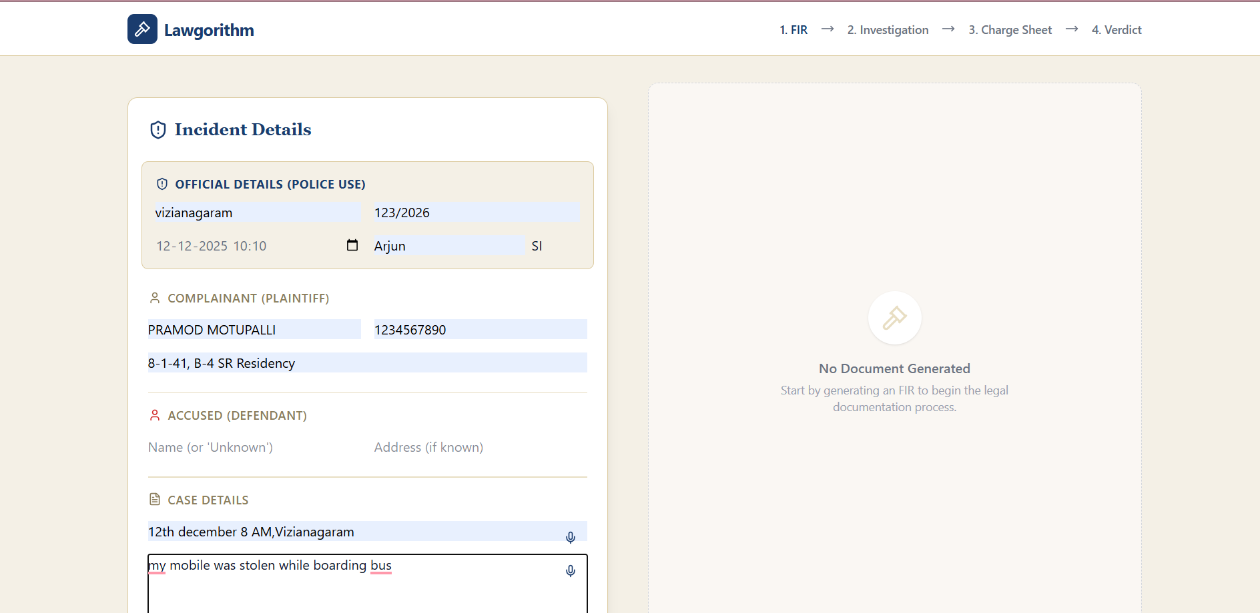
RESULTS

Slide 26
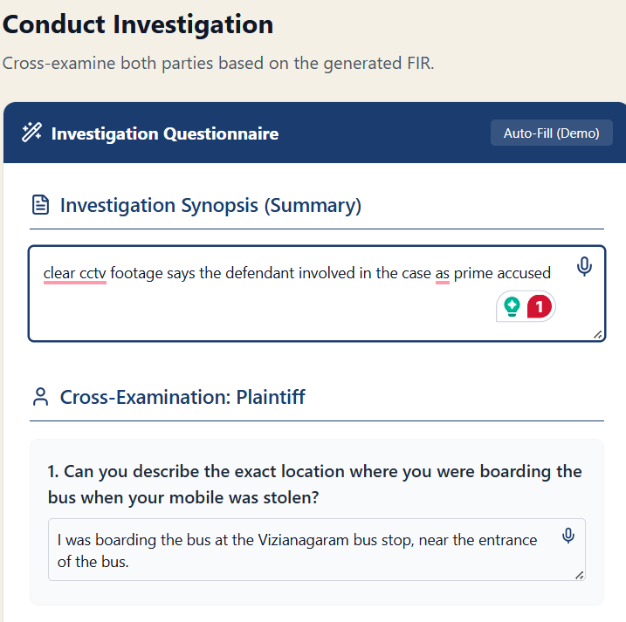
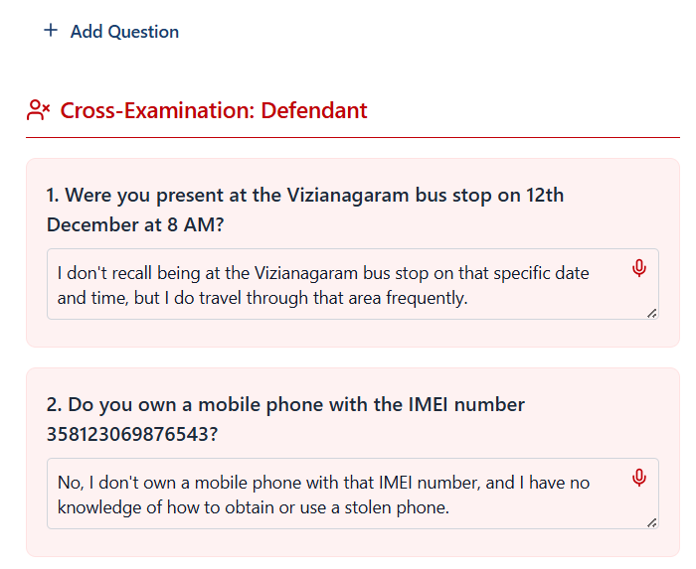
RESULTS

Slide 27
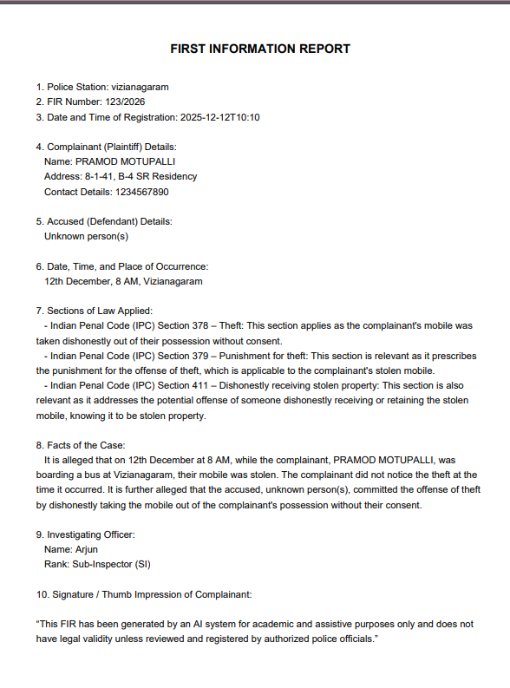
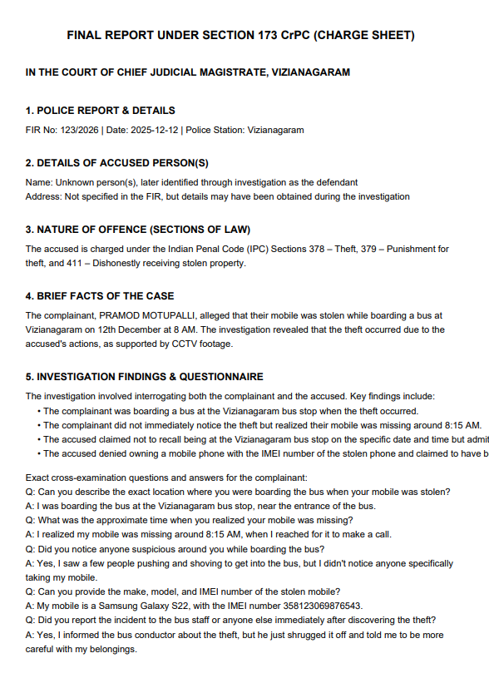
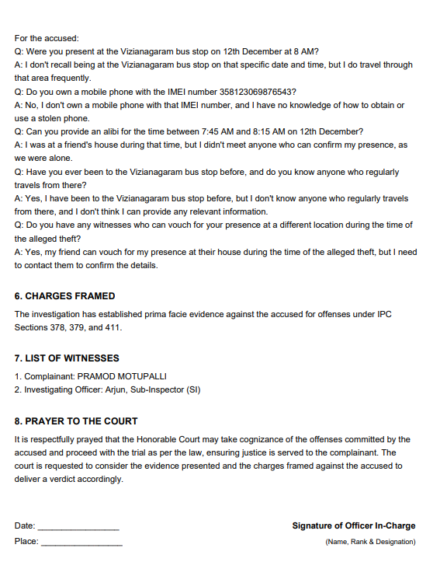
RESULTS

Slide 28
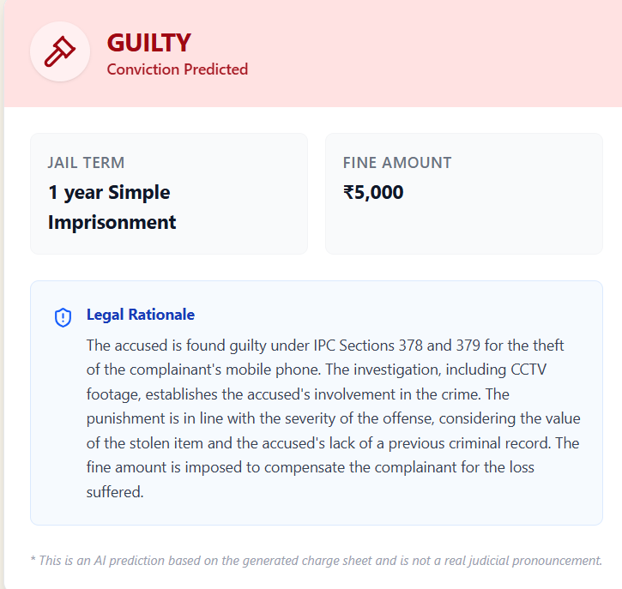
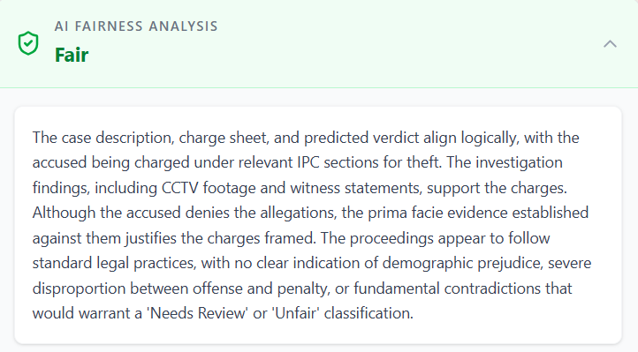
RESULTS

Slide 29
LIMITATIONS
English-only, no regional language support
API key, rate limit handling
Browser-dependent speech-to-text

Slide 30
CONCLUSION
Lawgorithm demonstrates how AI can responsibly assist the legal domain through explainable, rule-guided automation. By focusing on statutory logic rather than historical bias, the system ensures ethical alignment while improving efficiency in legal processes.
FUTURE SCOPE
Multi-jurisdiction legal support
Multilingual legal document generation
Enhanced explainable verdict summaries

